Slide 1

UNIT 1
Chapter 1.2

Slide 2
8051 Microcontroller
8051 microcontroller is designed by Intel in 1981. It is an 8-bit microcontroller. It is built with 40 pins DIP (dual inline package), 4kb of ROM storage and 128 bytes of RAM storage, 2 16-bit timers. It consists of are four parallel 8-bit ports, which are programmable as well as addressable as per the requirement. An on-chip crystal oscillator is integrated in the microcontroller having crystal frequency of 12 MHz.

Slide 3
Basic Terminology
A set of instructions written in a specific sequence for the computer to solve a specific task is called a program and software is a collection of such programs. The program stored in the computer memory in the form of binary numbers is called machine instructions. The machine language program is called object code. An assembly language is a mnemonic representation of machine language. Machine language and assembly language are low level languages and are processor specific. The assembly language program the programmer enters is called source code. The source code (assembly language) is translated to object code (machine language) using assembler.
Programs can be written in high level languages such as C, C++ etc. High level language will be converted to machine language using compiler or interpreter. Compiler reads the entire program and translate into the object code and then it is executed by the processor. Interpreter takes one statement of the high-level language as input and translate it into object code and then executes.

Slide 4
The 8051 Architecture
Salient features of 8051 microcontroller are given below.
Eight bit CPU
On chip clock oscillator
4Kbytes of internal program memory (code memory) [ROM]
128 bytes of internal data memory [RAM]
64 Kbytes of external program memory address space.
64 Kbytes of external data memory address space.
32 bi directional I/O lines (can be used as four 8 bit ports or 32 individually addressable I/O lines)
Two 16 Bit Timer/Counter: T0, T1
Full Duplex serial data receiver/transmitter
Four Register banks with 8 registers in each bank.
16-bit Program counter (PC) and a data pointer (DPTR)

Slide 5
The 8051 Architecture
Other salient features of 8051 microcontroller are given below.
8 Bit Program Status Word (PSW)
8 Bit Stack Pointer
Five vector interrupt structure (RESET not considered as an interrupt.)
8051 CPU consists of 8-bit ALU with associated registers like accumulator ‘A’, B register, PSW, SP, 16-bit program counter, stack pointer.
ALU can perform arithmetic and logic functions on 8-bit variables.
8051 has 128 bytes of internal RAM which is divided into
Working registers [00 – 1F]
Bit addressable memory area [20 – 2F]
General purpose memory area (Scratch pad memory) [30-7F]

Slide 6
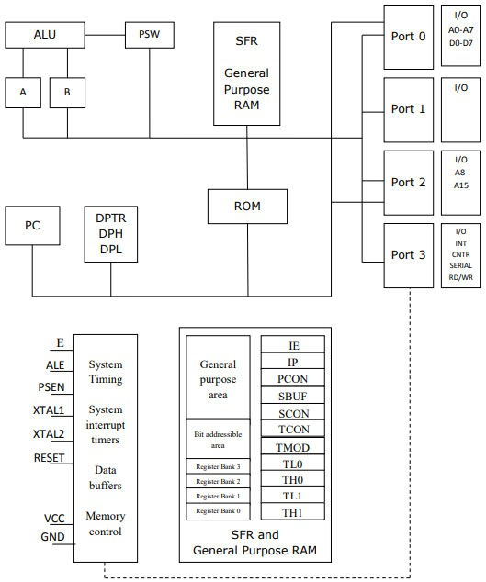

Slide 7
8051 has 4 K Bytes of internal ROM. The address space is from 0000 to 0FFFh. If the program size is more than 4 K Bytes 8051 will fetch the code automatically from external memory.
Accumulator is an 8 bit register widely used for all arithmetic and logical operations. Accumulator is also used to transfer data between external memory. B register is used along with Accumulator for multiplication and division. A and B registers together is also called MATH registers.
PSW (Program Status Word). This is an 8-bit register which contains the arithmetic status of ALU and the bank select bits of register banks.
CY | AC | F0 | RS1 | RS0 | OV | - | P

Slide 8
CY AC F0
carry flag
auxiliary carry flag
available to the user for general purpose
register bank select bits
overflow
parity
RS1, RS0
OV P
Stack Pointer (SP) – it contains the address of the data item on the top of the stack. Stack may reside anywhere on the internal RAM. On reset, SP is initialized to 07 so that the default stack will start from address 08 onwards.
Data Pointer (DPTR) – DPH (Data pointer higher byte), DPL (Data pointer lower byte). This is a 16-bit register which is used to furnish address information for internal and external program memory and for external data memory.
Program Counter (PC) – 16-bit PC contains the address of next instruction to be executed. On reset PC will set to 0000. After fetching every instruction PC will increment by one.

Slide 9
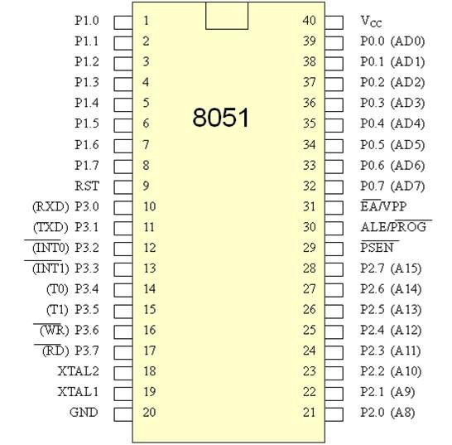
Pin Diagram

Slide 10
Pinout Description
Pins 1-8 | PORT 1. Each of these pins can be configured as an input or an output. It is bidirectional. It is used for variety of interfacing tasks.
Pin 9 | RESET. A logic one on this pin disables the microcontroller and clears the contents of most registers. In other words, the positive voltage on this pin resets the microcontroller. By applying logic zero to this pin, the program starts execution from the beginning.
Pins10-17 | PORT 3. Similar to port 1, each of these pins can serve as general input or output. Besides, all of them have alternative functions
Pin 10 | RXD. Serial asynchronous communication input or Serial synchronous communication output.
Pin 11 | TXD. Serial asynchronous communication output or Serial synchronous communication clock output.
Pin 12 | INT0. External Interrupt 0 input

Slide 11
Pin 13 | INT1. External Interrupt 1 input
Pin 14 | T0. Counter 0 clock input
Pin 15 | T1. Counter 1 clock input
Pin 16 | WR. Write to external (additional) RAM
Pin 17 | RD. Read from external RAM
Pin 18, 19 | XTAL2, XTAL1. Internal oscillator input and output. A quartz crystal which specifies operating frequency is usually connected to these pins.
Pin 20 | GND. Ground.
Pin 21-28 | Port 2. If there is no intention to use external memory then these port pins are configured as general inputs/outputs. In case external memory is used, the higher address byte, i.e. addresses A8-A15 will appear on this port. Even though memory with capacity of 64Kb is not used, which means that not all eight port bits are used for its addressing, the rest of them are not available as inputs/outputs.

Slide 12
Pin 29 | PSEN. Program Store Enable. If external ROM is used for storing program then a logic zero (0) appears on it every time the microcontroller reads a byte from memory.
Pin 30 | ALE. Address Latch Enable. Prior to reading from external memory, the microcontroller puts the lower address byte (A0-A7) on P0 and activates the ALE output. After receiving signal from the ALE pin, the external latch latches the state of P0 and uses it as a memory chip address. Immediately after that, the ALE pin is returned its previous logic state and P0 is now used as a Data Bus.
Pin 31 | EA. External Enable. By applying logic zero to this pin, P2 and P3 are used for data and address transmission with no regard to whether there is internal memory or not. It means that even there is a program written to the microcontroller, it will not be executed. Instead, the program written to external ROM will be executed. By applying logic one to the EA pin, the microcontroller will use both memories, first internal then external (if exists).

Slide 13
Pin 32-39 | PORT 0. 8-bit Port. Similar to P2, if external memory is not used, these pins can be used as general inputs/outputs. Otherwise, P0 is configured as address output (A0-A7) when the ALE pin is driven high (1) or as data output (Data Bus) when the ALE pin is driven low (0).
Pin 40 | VCC. +5V power supply.

Slide 14
Memory Organization
Internal RAM organization
External Memory Interfacing

Slide 15
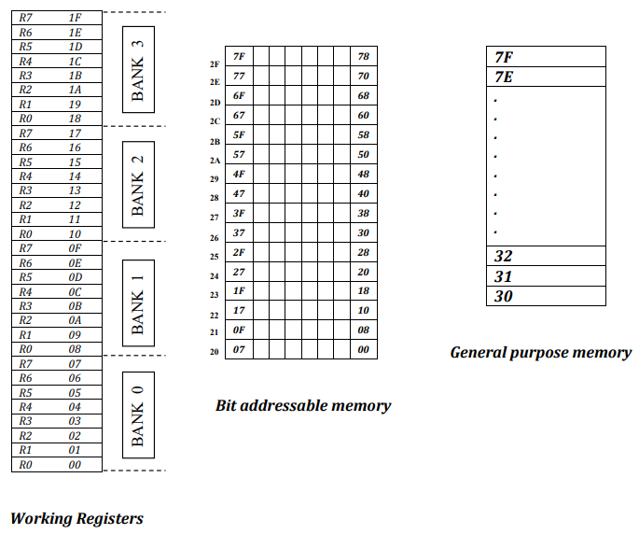
Internal RAM organization

Slide 16
Register Banks: 00h to 1Fh. The 8051 uses 8 general-purpose registers R0 through R7 (R0, R1, R2, R3, R4, R5, R6, and R7). There are four such register banks. Selection of register bank can be done through RS1, RS0 bits of PSW. On reset, the default Register Bank 0 will be selected.
Bit Addressable RAM: 20h to 2Fh. The 8051 supports a special feature which allows access to bit variables. This is where individual memory bits in Internal RAM can be set or cleared. In all there are 128 bits numbered 00h to 7Fh. Being bit variables any one variable can have a value 0 or 1. A bit variable can be set with a command such as SETB and cleared with a command such as CLR. Example instructions are:
SETB 25h; sets the bit 25h (becomes 1) CLR 25h; clears bit 25h (becomes 0)
Note, bit 25h is actually bit 5 of Internal RAM location 24h.
The Bit Addressable area of the RAM is just 16 bytes of Internal RAM located between 20h and 2Fh.

Slide 17
General Purpose RAM: 30h to 7Fh. Even if 80 bytes of Internal RAM memory are available for general-purpose data storage, user should take care while using the memory location from 00- 2Fh since these locations are also the default register space, stack space, and bit addressable space. It is a good practice to use general purpose memory from 30 – 7Fh. The general-purpose RAM can be accessed using direct or indirect addressing modes.
SFR Map. The set of Special Function Registers (SFRs) contains important registers such as Accumulator, Register B, I/O Port latch registers, Stack pointer, Data Pointer, PSW and various control registers. Some of these registers are bit addressable.

Slide 18
External Memory Interfacing
Eg. Interfacing of 16 K Byte of RAM and 32 K Byte of EPROM to 8051
Number of address lines required for 16 Kbyte memory is 14 lines and that of 32Kbytes of memory is 15 lines.

Slide 19
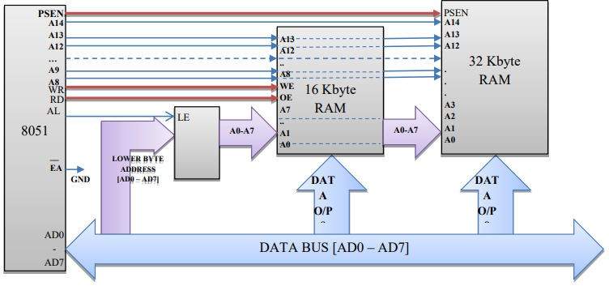
The connections of external memory are shown below.

Slide 20
The lower order address and data bus are multiplexed. De-multiplexing is done by the latch. Initially the address will appear in the bus and this latched at the output of latch using ALE signal. The output of the latch is directly connected to the lower byte address lines of the memory. Later data will be available in this bus. Still the latch output is address itself. The higher byte of address bus is directly connected to the memory. The number of lines connected depends on the memory size.
The RD and WR (both active low) signals are connected to RAM for reading and writing the data. PSEN of microcontroller is connected to the output enable of the ROM to read the data from the memory.
EA (active low) pin is always grounded if we use only external memory. Otherwise, once the
program size exceeds internal memory the microcontroller will automatically switch to external memory.

Slide 21
STACK
A stack is a last in first out memory. In 8051 internal RAM space can be used as stack. The address of the stack is contained in a register called stack pointer. Instructions PUSH and POP are used for stack operations. When a data is to be placed on the stack, the stack pointer increments before storing the data on the stack so that the stack grows up as data is stored (pre-increment). As the data is retrieved from the stack the byte is read from the stack, and then SP decrements to point the next available byte of stored data (post decrement). The stack pointer is set to 07 when the 8051 resets. So that default stack memory starts from address location 08 onwards (to avoid overwriting the default register bank i.e., bank 0).

Slide 22
E.g. Show the stack and SP for the following.
[SP]=07 [R6]=25H [R1]=12H [R4]=F3H
//CONTENT OF SP IS 07 (DEFAULT VALUE)
//CONTENT OF R6 IS 25H
//CONTENT OF R1 IS 12H
//CONTENT OF R4 IS F3H
MOV R6, #25H MOV R1, #12H MOV R4, #0F3H
PUSH 6 | [SP]=08 | [08]=[06]=25H | //CONTENT OF 08 IS 25H
PUSH 1 PUSH 4 | [SP]=09 [SP]=0A | [09]=[01]=12H [0A]=[04]=F3H | //CONTENT OF 09 IS 12H //CONTENT OF 0A IS F3H
POP 6 | [06]=[0A]=F3H | [SP]=09 | //CONTENT OF 06 IS F3H
POP 1 POP 4 | [01]=[09]=12H [04]=[08]=25H | [SP]=08 [SP]=07 | //CONTENT OF 01 IS 12H //CONTENT OF 04 IS 25H

Slide 23
TEXTBOOKS/REFERENCE BOOKS
TEXTBOOKS
T1 Kenneth Ayala, The 8051 Microcontroller, Cengage Learning India, 3rd Edition, Nov 2007
T2 B. Kanta Rao, Embedded Systems, PHI, 1st Edition, January 2011
T3 John Boxall, Arduino Workshop: A Hands-On Introduction with 65 Projects, No Starch Press, 1st Edition, May 2013
REFERENCE BOOKS
R1 B. Ram, Fundamentals of Microprocessors and Microcontrollers, DRP, 8th Edition, Nov 2021
R2 Massimo Banzi, Getting Started with Arduino, Make Community LLC, 3rd Edition, Jan 2015
R3 Jeremy Blum, Exploring Arduino: Tools and Techniques for Engineering Wizardry, Wiley, 1st Edition, Aug 2013
B. Video Links:
https://www.youtube.com/watch?v=ZxR3YtCV-n0
https://www.youtube.com/watch?v=OaaP5WIG7ro
https://www.youtube.com/watch?v=jHztC3jFw20

